Slide 1

UNIVERSITY INSTITUTE OF ENGINEERING
Bachelor of Engineering (Computer Science & Engineering)
Operating System (CST-328)
Subject Coordinator: Er. Kulvinder Singh(E8770)
DISCOVER . LEARN . EMPOWER

Slide 2
Lecture 7 Threads
Processes and Threads
fork() system call
Thread Approaches
Types of threads
Benefits of thread
Concept of multithreading
Linux thread management

Slide 3
Processes and Threads
The unit of dispatching is referred to as a thread or lightweight process
The unit of resource ownership is referred to as a process or task
Multithreading - The ability of an OS to support multiple, concurrent paths of execution within a single process.
A running process may issue system calls to create new processes:
In UNIX: fork system call

Slide 4
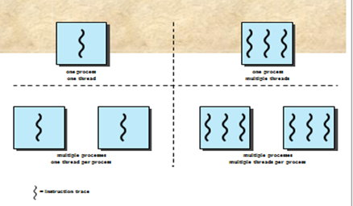
Single Threaded Approaches
Multithreaded Approaches
A Java run-time environment is an example of a system of one process with multiple threads
A single thread of execution per process,
in which the concept of a thread is not recognized, is referred to as a single-threaded approach
MS-DOS is an example.

Slide 5
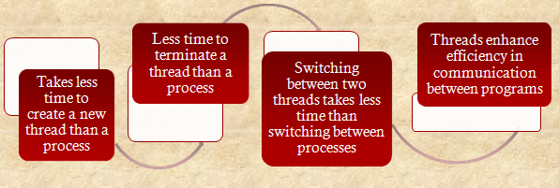
Benefits of Threads

Slide 6

Thread operations associated with a change in thread state are:
The key states for a thread are:
Running
Ready
Blocked
Spawn
Block
Unblock
Finish

Slide 7
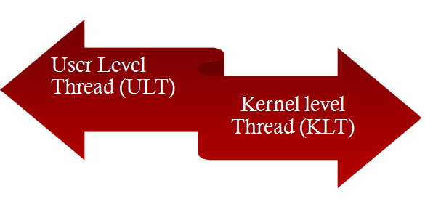
Types of Threads

Slide 8
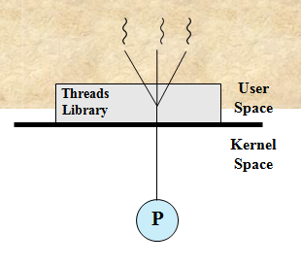
User-Level Threads (ULTs)
All thread management is done by the
application
The kernel is not aware of the existence of threads

Slide 9

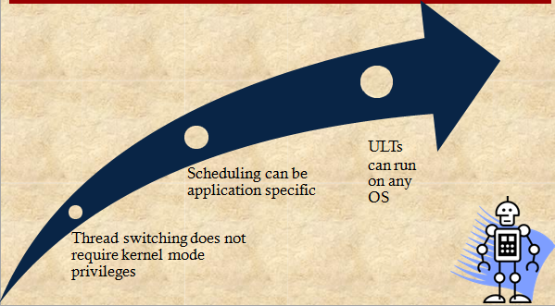

Slide 10
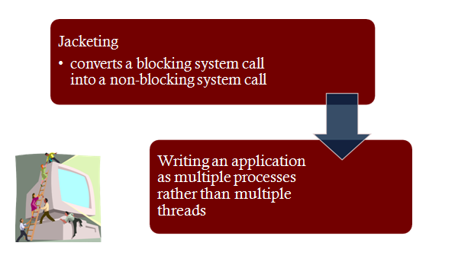
Disadvantages of ULTs
In a typical OS many system calls are blocking
as a result, when a ULT executes a system call, not only is that thread blocked, but all of the threads within the process are blocked
In a pure ULT strategy, a multithreaded application cannot take advantage of multiprocessing
Overcoming ULT Disadvantages

Slide 11
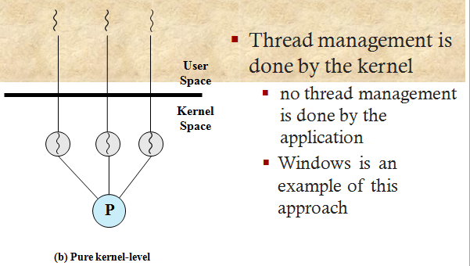
Kernel-Level Threads (KLTs)

Slide 12
Advantages of KLTs
The kernel can simultaneously schedule multiple threads from the same process on multiple processors
If one thread in a process is blocked, the kernel can schedule another thread of the same process
Kernel routines can be multithreaded

Slide 13
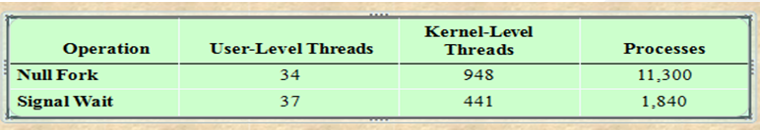
Disadvantage of KLTs
 The transfer of control from one thread to another within the same process requires a mode switch to the kernel
Thread and process Operation Latencies :

Slide 14
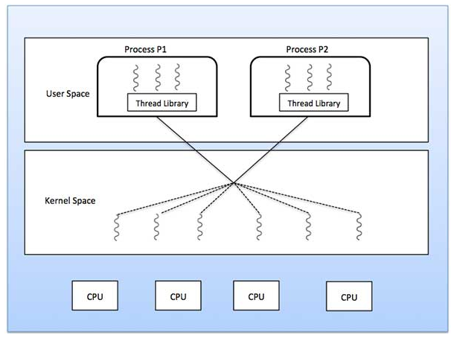
Concept of Multithreading
Multithreading Models
Some operating system provide a combined user level thread and Kernel level thread facility. Solaris is a good example of this combined approach. In a combined system, multiple threads within the same application can run in parallel on multiple processors and a blocking system call need not block the entire process.
Multithreading models are three types:
Many to many relationship.

Slide 15
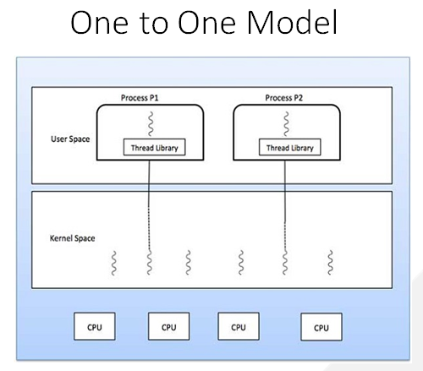
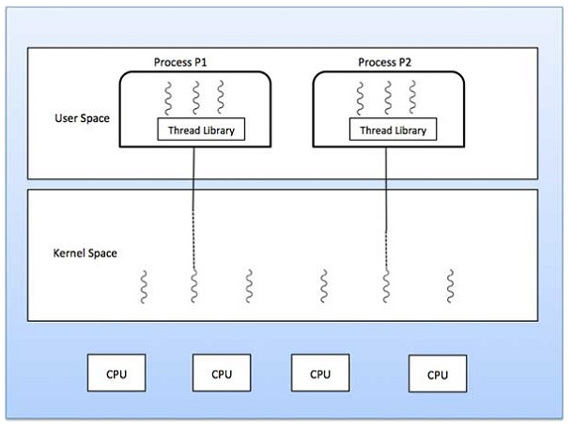
Many to One Model

Slide 16
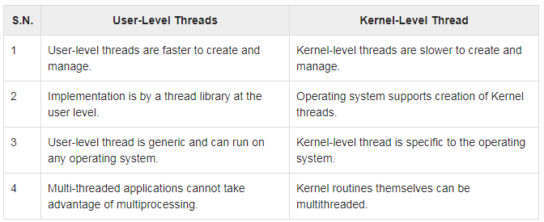
Difference between User-Level & Kernel-Level Thread

Slide 17
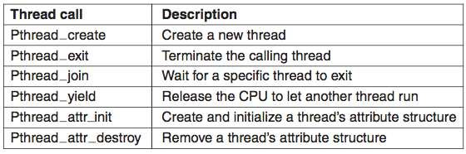
Linux Thread Management
How are threads implemented in Unix / Linux (posix) systems? Any ideas?
The same way that we have POSIX systems calls...
...We also have POSIX threads...
Care to guess how the POSIX threads are named Any ideas?
Answer : Pthreads

Slide 18
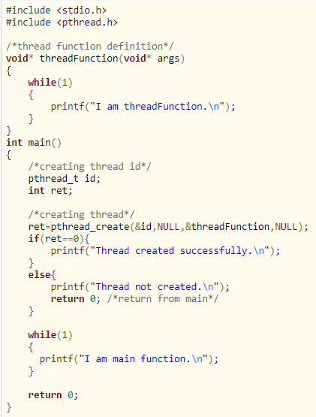
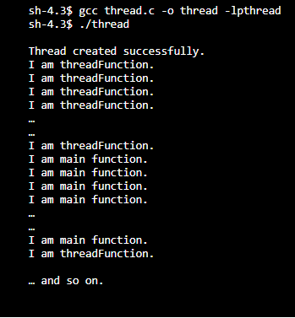
Pthread_create
Then, how to compile C program with pthread.h library?
The command is:
gcc thread.c -o thread -lpthread

Slide 19
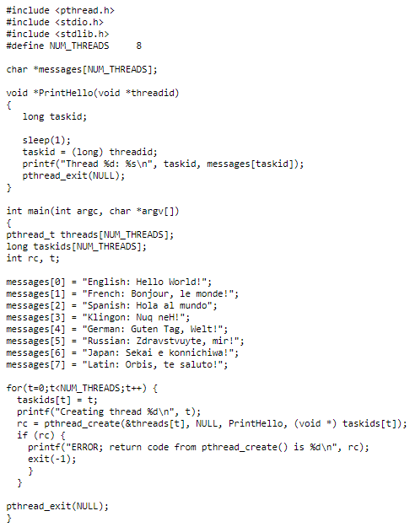
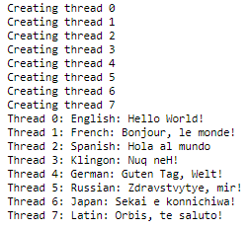
Thread Argument Passing
Output

Slide 20
Conclusion
This Topic enables students to understand What is difference between a thread and a process, thread types, multithreading, thread argument passing etc.

Slide 21
References
https://www.includehelp.com/c-programming-questions/compiling-program-with-pthread-library-linux.aspx
https://www.studytonight.com/operating-system/multithreading
https://computing.llnl.gov/tutorials/pthreads/

